Slide 1

Flip Robo Technologies
MICRO CREDIT DEFAULTER MODEL
Submitted By -
Ganesh kumbhar

Slide 2
The problem
Introduction
Problem statement
Challenges
A Microfinance Institution (MFI) is an organization that offers financial services to low income populations. MFS becomes very useful when targeting especially the unbanked poor families living in remote areas with not much sources of income
Our client that is in Telecom Industry is collaborating with an MFI to provide micro-credit on mobile balances to be paid back in 5 days. The Consumer is believed to be defaulter if he deviates from the path of paying back the loaned amount within the time duration of 5 days.
To find if in the future customer will be defaulter or not and also to find the relationship between different factor which affects the loan repayment

Slide 3
Mathematical/ Analytical Modeling of the Problem
Outliers
Negative Values
Grouping
Dropping Columns
Challenge 2
We chose to remove the outliers by the distribution of data and for that we used Z score and as our data is important to us so expanded our standard threshold value of Z score that is +-3 to +-5 so that we will lose less data.
In this data set many features have negative value which is not even possible so with the understanding of description of feature we change data from negative to positive.
The data is given to us in continuous format and it will be very hard for us to classify people into 4 categories i.e in 1st , 2nd ,3rd and 4th quartile, and we made a group of people based on their age on the network, amount they spent, loan they take.
We dropped the columns on basis of their
Uniqueness
Zero Variance
Correlation

Slide 4
We remove outliers by the main distribution method that is by Z-Score, keeping the threshold value + -5.
The data set has very high skewness and we removed it by using a cube root method.
Data Pre Processing
START
1
2
3
4
We Checked if the mobile number can give us any information and as a result it didn't so we dropped that column.
We made a group of various columns into 1st ,2nd, 3rd and 4th quartile to do the data analysis.

Slide 5
We removed all the data which has 0 variance as they provide no value to machine learning.
We used train_test_split to split data for machine learning.
As data set is imbalance by 87% so we did the oversampling by SMTOTE
5
6
7
8
9
To make data in standard scale we used the Standard Scaling method.
Then we removed all the features which have high correlation between themselves.

Slide 6
Visualization

Slide 7
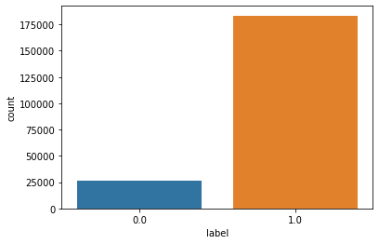
Label
We see that the data is highly imbalanced and approx 87%, so after seeing this graph we decided to balance the data by oversampling.

Slide 8
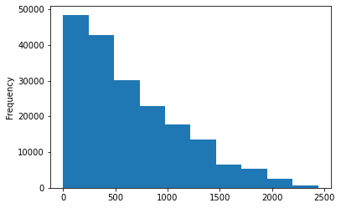
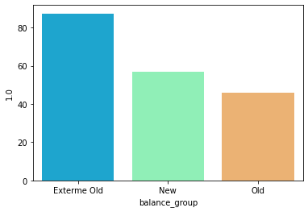
Effect of age on loan repayment
More people are joining the network
With the time people are leaving the network
87% extreme old and 56% new people are most likely to return loan as they develop loyalty towards telecom
but as person become little old then they are more likely to be faulty only 45% returned the loan

Slide 9
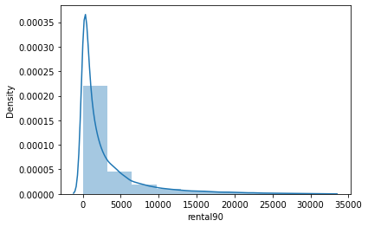
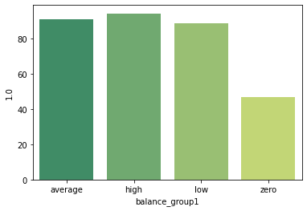
Average Main Account Balance
People with High balance have 94% probability of returning the loan, Average people have 90% probability of returning the loan, this becomes more low when it reaches 88% for low balance and 46% for zero balance.

Slide 10
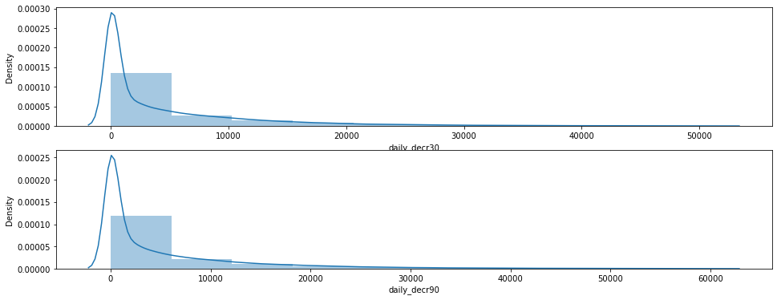
Daily Amount Spent
Most of the people spent amount between 0-5000 and when we go beyond that we see sudden drop in the customer who spent more than 5000 as their daily amount

Slide 11
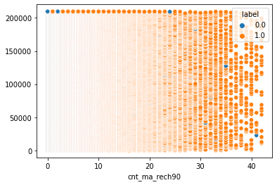
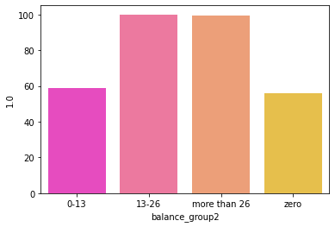
Number of time people did recharge
People who are doing recharge more than 26 times have 99% probability of returning the loan, People who are doing recharge between 13-26 times have 100% probability of returning the loan, this becomes more low when it reaches 58% for recharges between 0-13 and 56% for times. People who are doing recharge more than 13 times in 90 days are surely going to return the loan

Slide 12
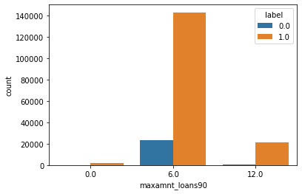
Maximum Amount of Loan
Most of the people took the loan 6 times in the last 30 Days, but they also returned the loan, also most of the people who didn't return the loan falls in this category. So, it is advised that when max. Loan amount reaches 6, red flags should be raised

Slide 13
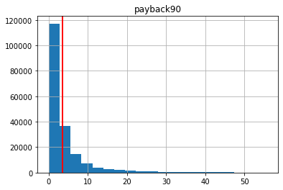
Payback in 90 Days
Most of the people paid back around in 3 days, so people who didn't return the money till 10 days are most likely to be defaulters.

Slide 14
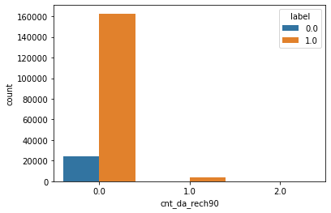
Data Account recharge
People who didn't do data recharge are most likely to take a loan and the factor of taking loan and not taking loan is another thing, here we see if a person is doing data recharge are more likely that they will not take any loan.

Slide 15
Machine Learning Model

Slide 16
Problem Solving Approaches
Feature Selection
Imbalance Dataset
Scaling
Skewness
Challenge 2
We used two approaches to select the feature first selection of feature by 0 variance and second selection of feature by the internal correlation.
The data is highly imbalanced about 87% and to make a model more precise we used over sampling method to do the balancing of a data
The scale of data has high variance and to put data in in one scale which will increase the efficiency of our model for that we use standard scaler library.
The data is very much skewed and to remove the skewness we used cube root method this method is capable of dealing with high skewness

Slide 17
Models Used
Models
Normal Models
Bagging/Boosting
Decision Tree Classifier
GaussianNB
RandomForestClassifier
AdaBoostClassifier
GradientBoostingClassifier
BaggingClassifier
ExtraTreesClassifier

Slide 18
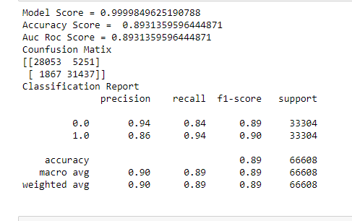
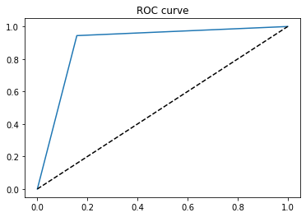
When we see the result of matrices we see that the we see that extra tree classifier has best accuracy score, f1 score, auc_roc score ann cross val score
Accuracy = 89%
F1-Score = 89%
Auc Roc Score = 89%
Cross Val Score = 91%
and AUC_ROC_Curve touching corner
Final Model
Extra Tree Classifier

Slide 19
Conclusion
Limitation
With the introduction of micro loans many people join the network but because of various factors they start leaving the network.
We see that people you have low balance or jio recharge and have probability of not giving a loan more than 50% still got the loan
People with high probability returning the loan should have provided a loan instantly and bigger amount is possible
All the people who are using the internet can be considered as literate and literacy rate has a huge effect on returning the loan.
The data is collected not efficiently and because of that we are getting values which are impossible for the features the data has extreme outliers that cannot be removed
The SVC model and K neighbours model is taking too much time
we can increase the efficiency of a model by selecting a better method to remove outliers and skewness also how to make the search of perfect model in a way that if we want to change some parameters in model then we don't have to run all the model again

Slide 20
Thank You

